Slide 1
BTRFS Mystic Clones
End Term Presentation
Study and Improvement of the page cache utility for cloned files in the BTRFS File System

Slide 2
Percentage Contribution
Chitwan Goel (210295) - 32.5%
Geetika (210392) - 17.5%
Parinay Chauhan (200667) - 32.5%
Shrey Bansal (210997) - 17.5%

Slide 3
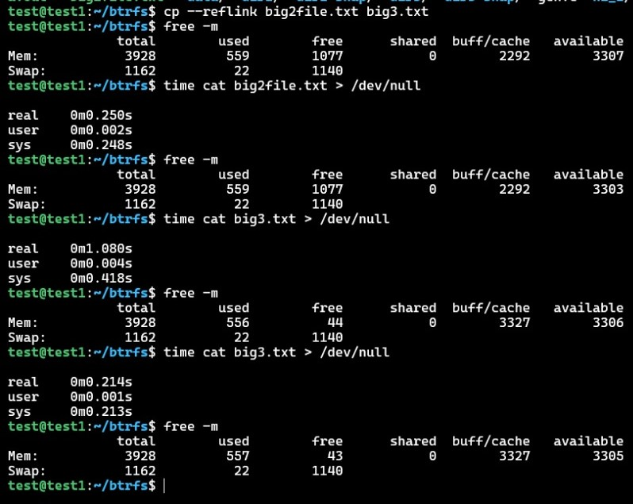
Recap

Slide 4
Assumptions
No Multi Level Parent-Child Relations: We assume no multi level parent-child relationships, neglecting scenarios like cloning a child from another child
Single Parent for a File: Our implementation doesn't accommodate files having multiple parents or parent overwriting scenarios
No eviction of parent inode: We assume if a child inode is present in memory then the corresponding parent inode is also present
Limit on Clones: We assume a maximum of 16 clones per file (MAX_CHILDREN)

Slide 5
Modifications Made by Us
Structures Modified -
struct inode
Functions Defined
filemap_get_pages_parent()- It gets the shared pages from the parent cache(if shared pages are not present in parent page cache, then the pages are read in parent cache ) so that the child can read
btrfs_copy_page_cache()- Copies the shared pages (between parent and children) to the cache of children

Slide 6
Functions Modified by Us
btrfs_clone()- Sets the parent child relationship
btrfs_remap_file_range()- Sets the xattributes while cloning in child and parent
btrfs_do_write_iter()- Changes the sharing bitmaps suitably when writing to parent or child and copies the cached shared pages of parent in children
filemap_read()- Read pages from parent if they are shared
inode.c/btrfs_unlink()- Removes the Parent child attributes set by us (Xattributes Parent and size) and Inode parent child attributes (like parent_child_bitmap, parent etc)
open.c/do_truncate()- Copies the contents of parent page pache in child and removed the parent child relationship
btrfs_read_locked_inode()- Rebuilds the bitmaps arrays for parent and child using the xattributes (while restoring inode)

Slide 7
Strategies
Metadata- Maintained information about inode’s parent(memory and disk) , children inode array and made a bitmap array that stores which pages are shared between parent and child (only memory)
Cloning a file- Set the information regarding parent and bitmap
Read from the cloned file- If the page is shared between parent and child then if it is read from the parent (If not in parent cache then parent reads that page in its own cache)
Write to parent file- If a write happens to parent page then we copy that page if found in parent cache to the children cache and update the bitmaps accordingly
Write to child file- We just updated the child bitmap array indicating no sharing

Slide 8
Strategies
Removal/truncation of parent file- We copy the shared pages in parent page cache to children and remove the parent child relationship in children
Removal/truncation of child file- We update the children array of parent inode, if it is the last child we free the parent bitmap array
Locking- Ensured correctness on concurrent accesses
Persistence- XAttributes are used to rebuild the bitmap array of parent and child (required in cases like reboots, crashes, or eviction of inodes from memory)

Slide 9
Metadata
Augment struct inode with additional attributes.

Slide 10
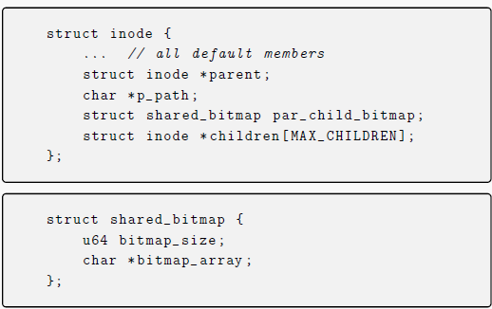
Metadata

Slide 11
Cloning a File
Set the information regarding parent and bitmap

Slide 12

Cloning a File
*
*
Parent File
Cloned File
children
cp --reflink
par_child_bitmap
1
1
1
1
1

Slide 13
Read from Cloned File
If the page is shared between parent and child then it is read from the parent
If the page is not in parent cache then parent reads that page in its own cache

Slide 14
Read from Cloned File
Cloned File
0
1
1
0
1

Slide 15
Read from Cloned File
Cloned File
filemap_read()
Reading from chunks of continuous pages
0
1
1
0
1
0
1
1
0
0
0
1

Slide 16
Read from Cloned File
Cloned File
filemap_read()
Reading from chunks of continuous pages
0
1
1
0
1
0
1
1
0
0
0
1
filemap_get_pages()
Unshared page
Disk
Child Page Cache

Slide 17
Read from Cloned File
Cloned File
filemap_read()
Reading from chunks of continuous pages
0
1
1
0
1
0
1
1
0
0
0
1
Page shared with Parent
filemap_get_pages_parent()
Parent Page Cache
Disk

Slide 18
Read from Cloned File
Cloned File
filemap_read()
Reading from chunks of continuous pages
0
1
1
0
1
0
1
1
0
0
0
1
filemap_get_pages()
Unshared page
Disk
Child Page Cache

Slide 19
Write to Cloned File
We just updated the child bitmap array indicating no sharing

Slide 20
Write to Cloned File
Cloned File
0
1
1
0
1
write range

Slide 21
Write to Cloned File
Cloned File
btrfs_do_write_iter()
0
1
1
0
1
0
0
0
0
1
write range
Unshare the pages which have been written

Slide 22
Write to Parent File
If a write happens to parent page then we copy that page if found in parent cache to the children cache and update the bitmaps accordingly

Slide 23
Write to Parent File
Parent File

Slide 24
Write to Parent File
Parent File
children
*
*
*
*
Bitmap of corresponding child
0
1
1
0
1
0
0
0
0
1
write range
Unshare the pages in the write range
Parent Page Cache
Copy Page Cache
Child Page Cache
btrfs_copy_page_cache()

Slide 25
Write to Parent File
Parent File
children
*
*
*
*
Bitmap of corresponding child
0
1
1
0
0
0
0
0
0
0
write range
Unshare the pages in the write range
Parent Page Cache
Copy Page Cache
Child Page Cache
btrfs_copy_page_cache()

Slide 26
Write to Parent File
Parent File
children
*
*
*
*
Bitmap of corresponding child
0
1
0
0
1
0
0
0
0
1
write range
Unshare the pages in the write range
Parent Page Cache
Copy Page Cache
Child Page Cache
btrfs_copy_page_cache()

Slide 27
Truncate/Delete Cloned File
We update the children array of parent inode

Slide 28
Truncate/Delete Cloned File
Cloned File
Parent File
1
1
1
0
1
children
*
*
*
*

Slide 29
Truncate/Delete Cloned File
Cloned File
Parent File
1
1
1
0
1
children
Free allocated memory
*
*
*

Slide 30
Truncate/Delete Parent File
We copy the shared pages in parent page cache to children and remove the parent child relationship in children

Slide 31
Truncate/Delete Parent File
Parent File
children
*
*
*
*
btrfs_copy_page_cache()
Parent Page Cache
Copy Page Cache
Child Page Cache

Slide 32
Truncate/Delete Parent File
Parent File
children
*
*
*
*
Free allocated memory

Slide 33
Truncate/Delete Parent File
Parent File
children
*
*
*
btrfs_copy_page_cache()
Parent Page Cache
Copy Page Cache
Child Page Cache

Slide 34
Truncate/Delete Parent File
Parent File
children
*
*
*
Free allocated memory

Slide 35
Truncate/Delete Parent File
Parent File
children
*
*
btrfs_copy_page_cache()
Parent Page Cache
Copy Page Cache
Child Page Cache

Slide 36
Truncate/Delete Parent File
Parent File
children
*
*
Free allocated memory

Slide 37
Deadlock Problem
Child Deletion
Write in Parent
Child acquires its own Lock
Parent acquires its own Lock
Child trying to acquire Parent Lock to change Parent Metadata
Parent trying to acquire Child Lock to copy page cache and unset bits
Circular dependence

Slide 38
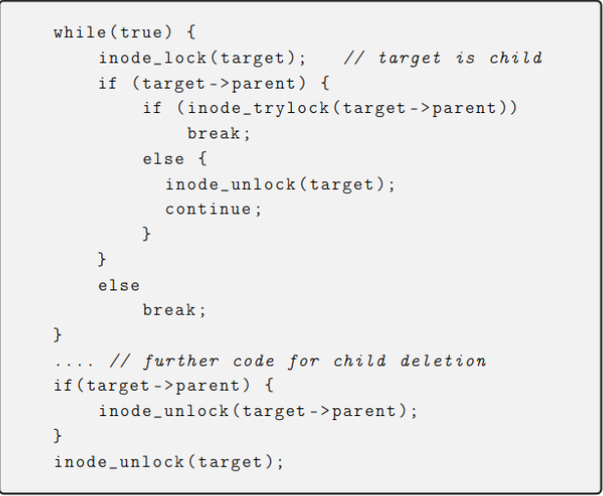
Deadlock Solution

Slide 39
Reader Locks
Naive Approach
Latency Issues
Process Might Sleep with Lock
Our Solution
Folio Optimization
Correctness of Folio Optimization

Slide 40
Persistence
XAttributes are used to rebuild the bitmap array of parent and child (required in cases like reboots, crashes, or eviction of inodes from memory)

Slide 41
Setting Extended Attributes
*
*
Parent File
Cloned File
children
cp --reflink
setxattr(parent)
setxattr(bmap_size)
setxattr(bmap_size)
par_child_bitmap
1
1
1
1
1

Slide 42
Persistence when parent is called
Parent File
Children array
Bitmap of size bmap_size
1
1
1
1
1

Slide 43
Persistence when parent is called
Parent File
Children
After Write
1
1
1
1
1
0
0
1
1
1
Write range
Unshare the pages which have been written

Slide 44
Persistence when child is called
Child File
The parent in memory inode is accessed using the parent inode number xattr
If parent is not already called, we call it first before proceeding with the child protocol

Slide 45
Persistence when child is called
Child File
Parent file
0
0
1
1
1

Slide 46
Persistence when child is called
Child File
Parent file
0
0
0
0
0
0
0
1
1
1

Slide 47
Persistence when child is called
Child File
Parent file
iterate_inodes_from_logical()
0
1
1
0
1

Slide 48
Persistence when child is called
Child File
Parent file
&
0
1
1
0
1
0
0
1
1
1
0
0
1
0
1

Slide 49
Persistence when child is called
Parent File
Children
Child File

Slide 50
Tests
Reader-Writer
Reader-Writer-Create
Reader-Writer-Destroy
Reader-Writer-Create-Destroy
Reader-Writer-Parent Delete

Slide 51
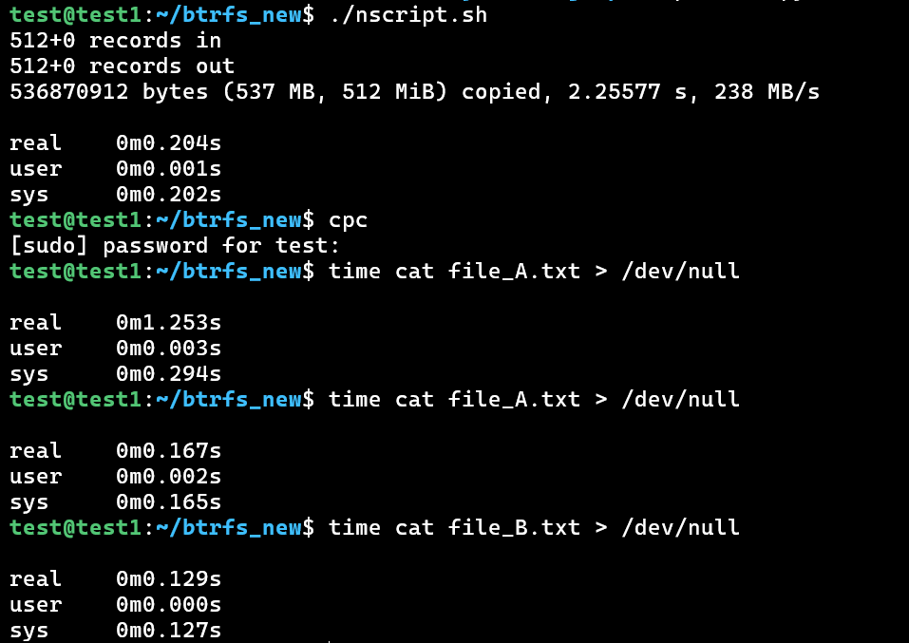
Demo
Child reading through parent cache -
When parent was read twice, it was in cache. Now reading the child took very less time
nscript.sh generates parent file_A.txt and child file_B.txt

Slide 52
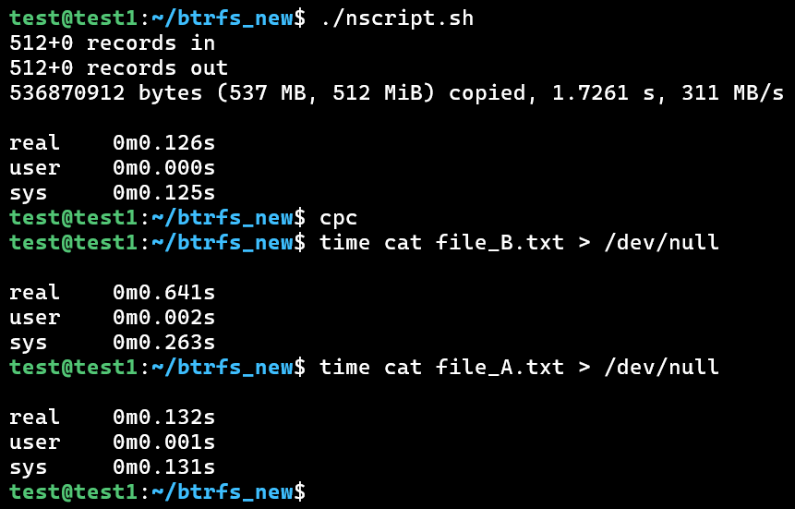
Demo
Child flooding the parent cache -
When child was read first, it brought the parent content into cache since it reads through parent. So reading the parent took less time
nscript.sh generates parent file_A.txt and child file_B.txt

Slide 53
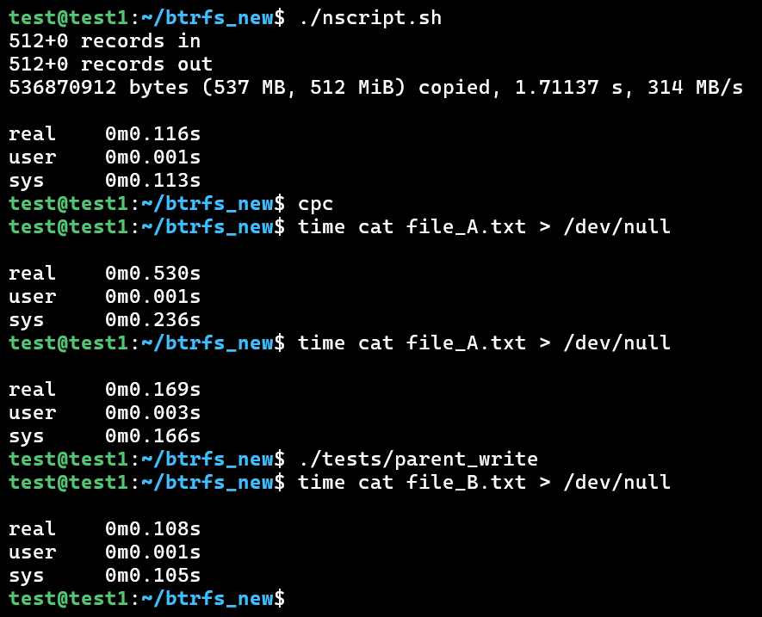
Demo
Copying of cache from parent to child during write to parent -
When parent was written, cache was copied to child. Reading the child took less time
nscript.sh generates parent file_A.txt and child file_B.txt

Slide 54
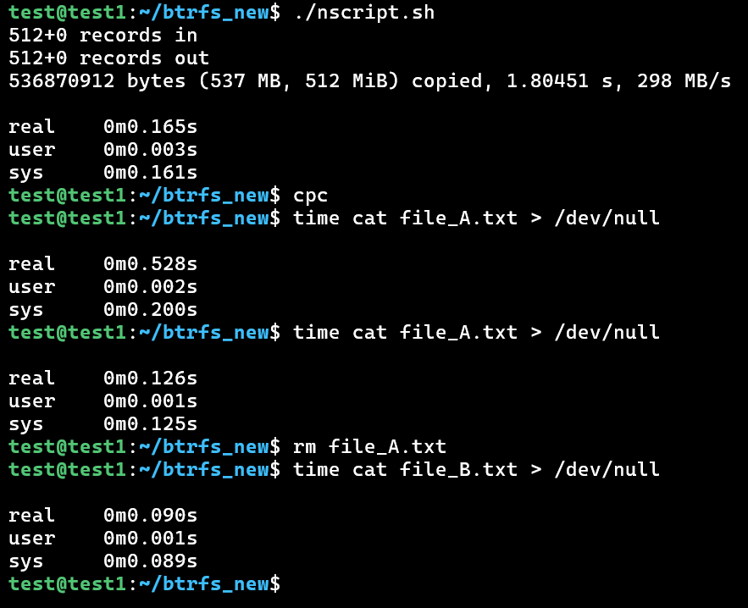
Demo
Copying of cache from parent to child during parent deletion -
When parent was deleted, cache was copied to child. Reading the child took less time
nscript.sh generates parent file_A.txt and child file_B.txt

Slide 55
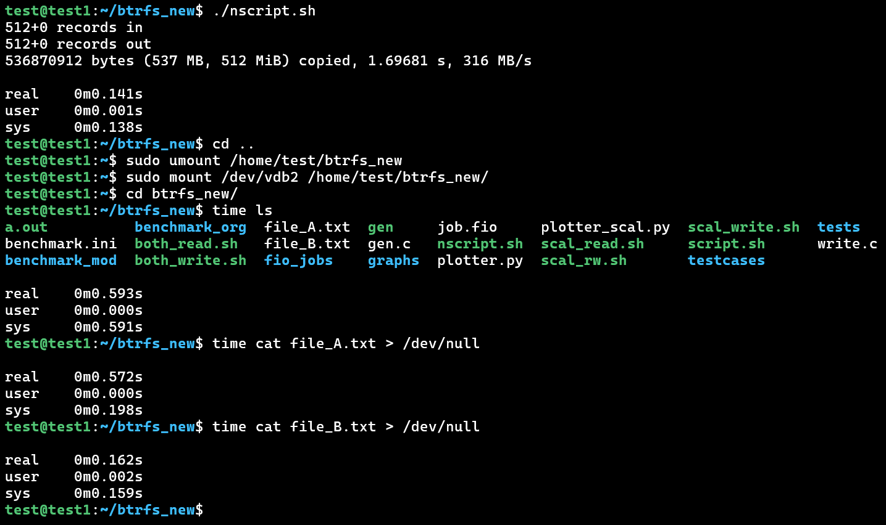
Demo
Persistence of parent child relation -
Unmounting and remounting retains parent child relation. Large time for ls taken due to building of bitmaps and other relationships
nscript.sh generates parent file_A.txt and child file_B.txt

Slide 56
Results

Slide 57
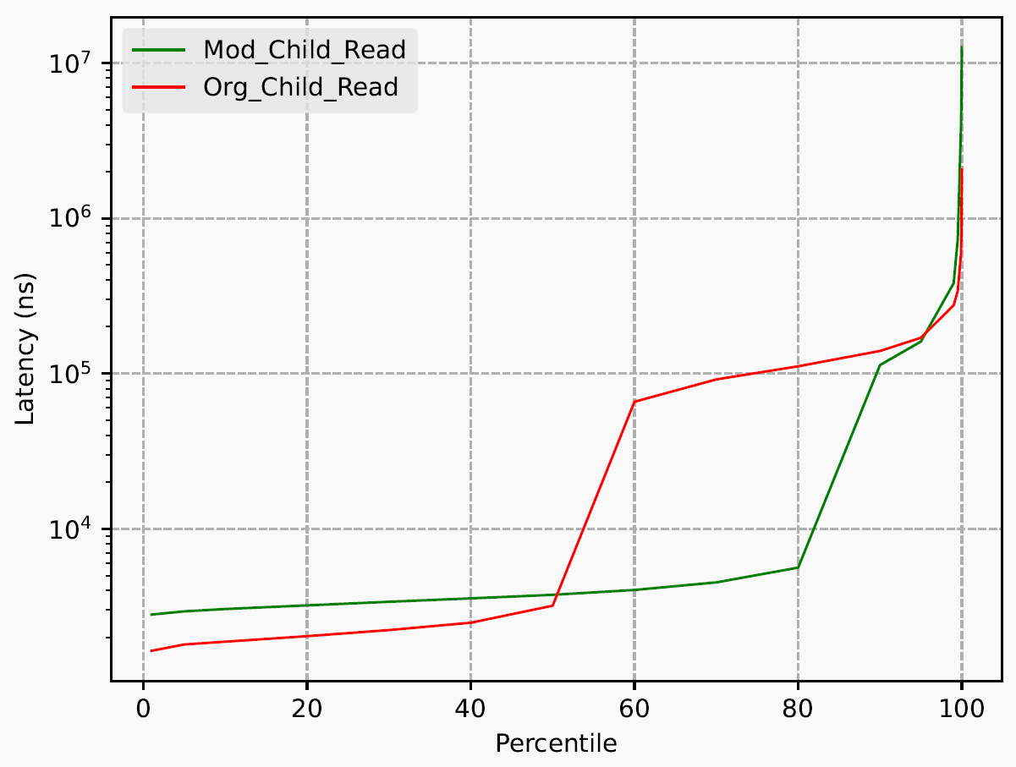
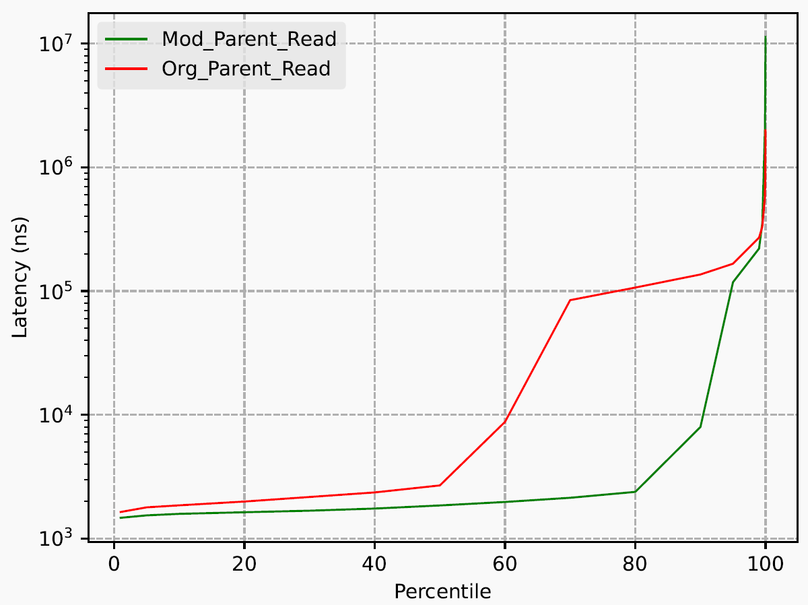
Comparison of latencies, with both parent and child reading

Slide 58
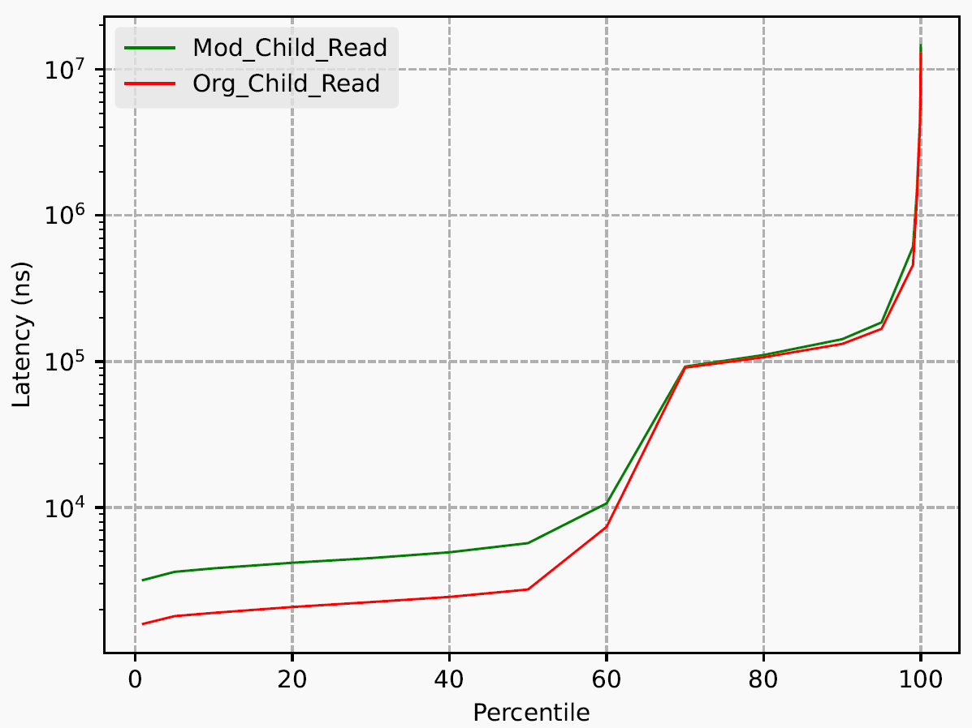
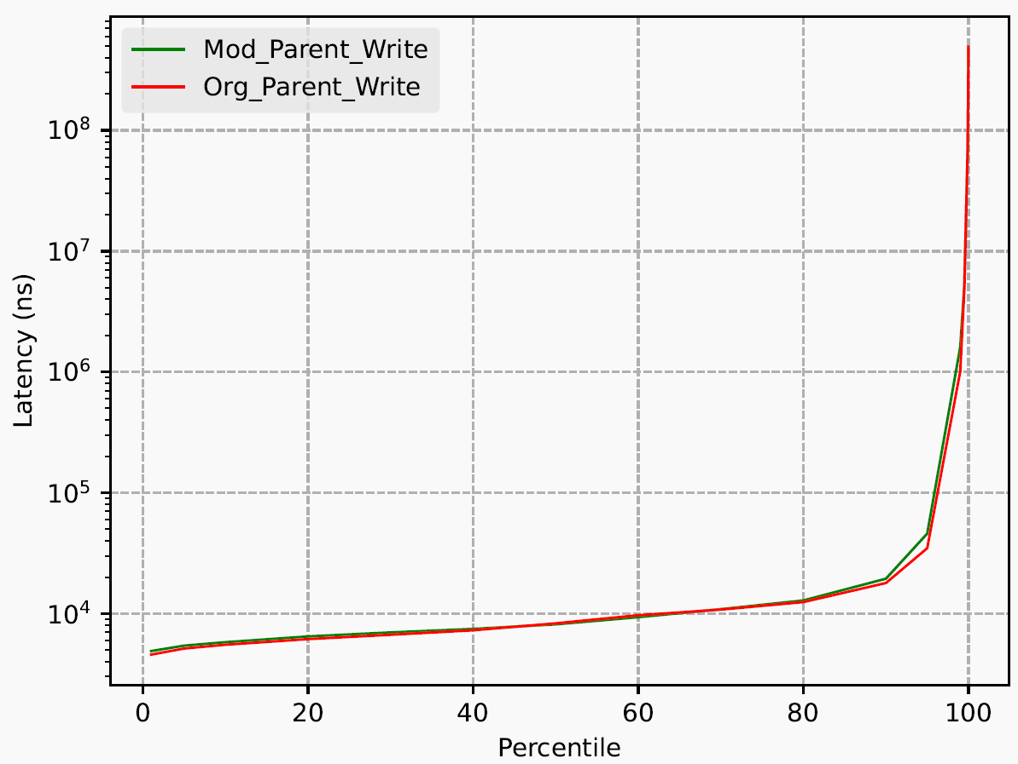
Comparison of latencies, with child reading and parent writing

Slide 59
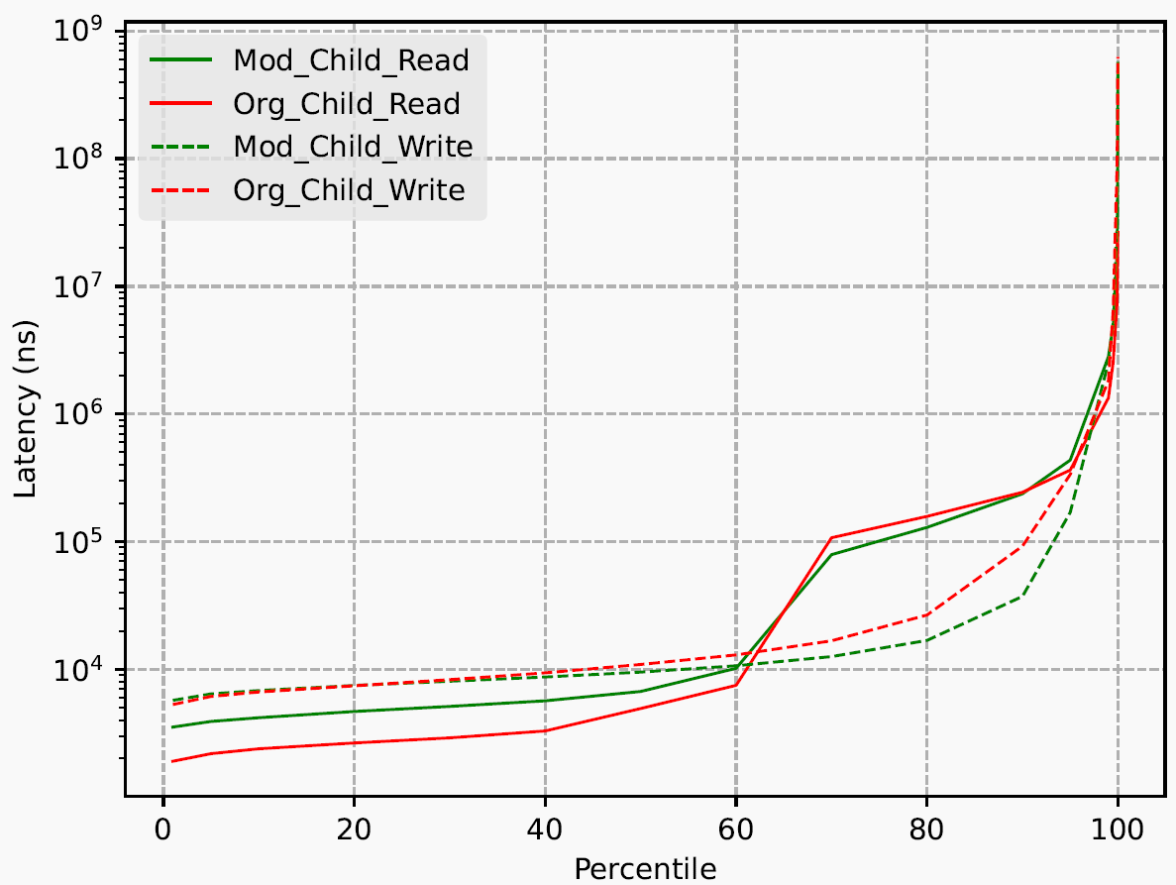
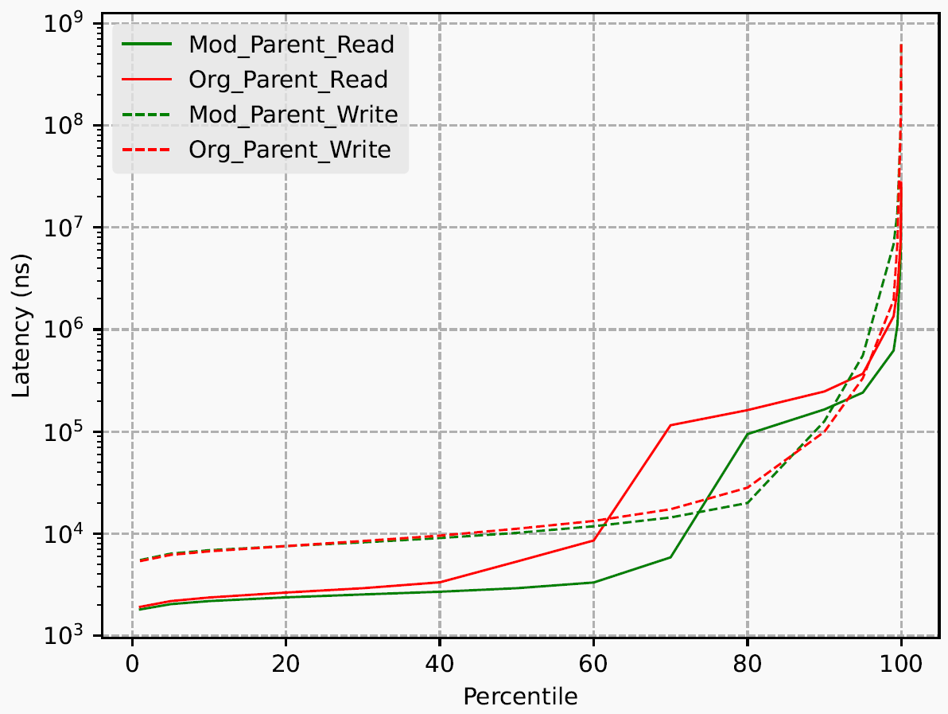
Comparison of latencies, with both child and parent reading and writing

Slide 60
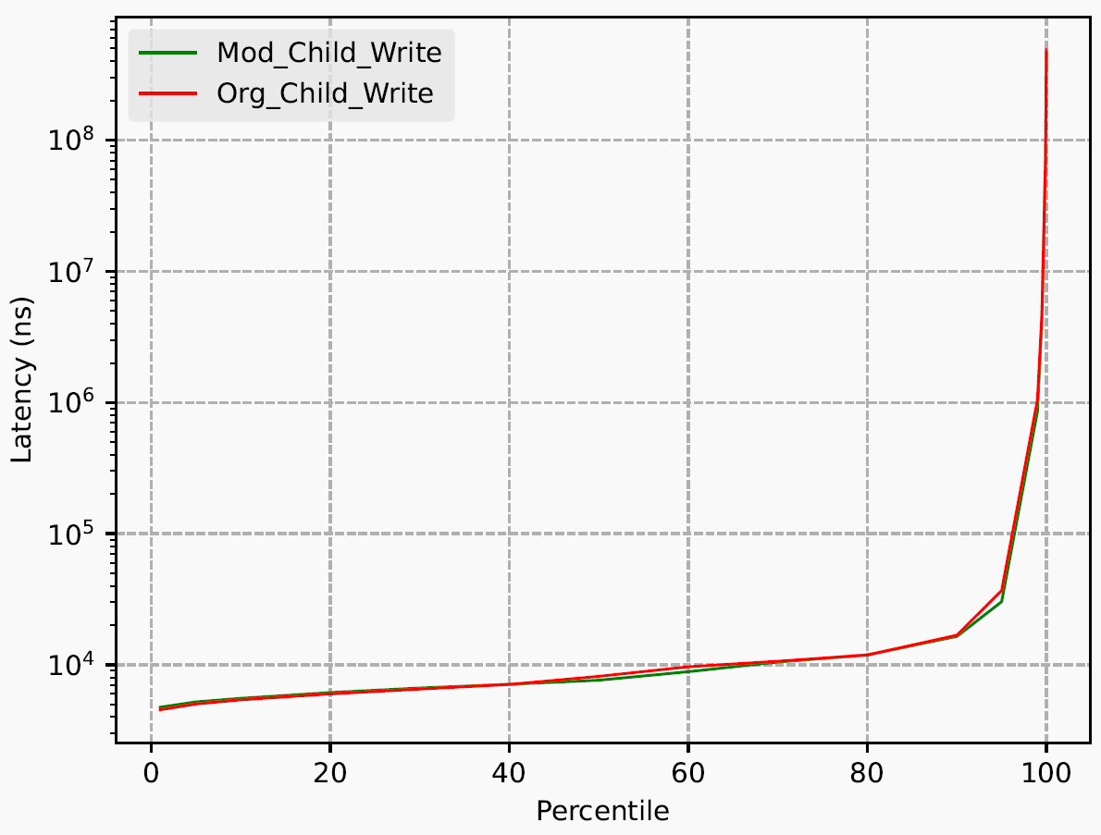
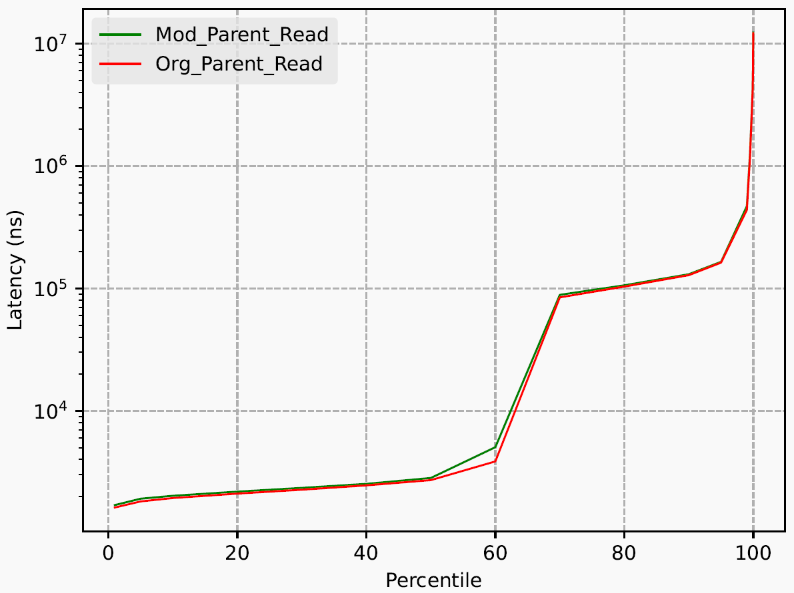
Comparison of latencies, with child writing and parent reading

Slide 61
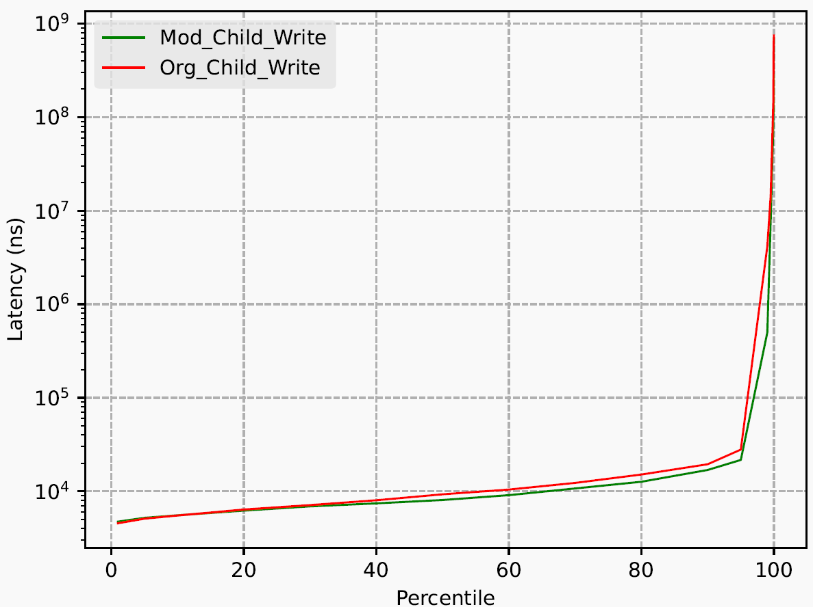
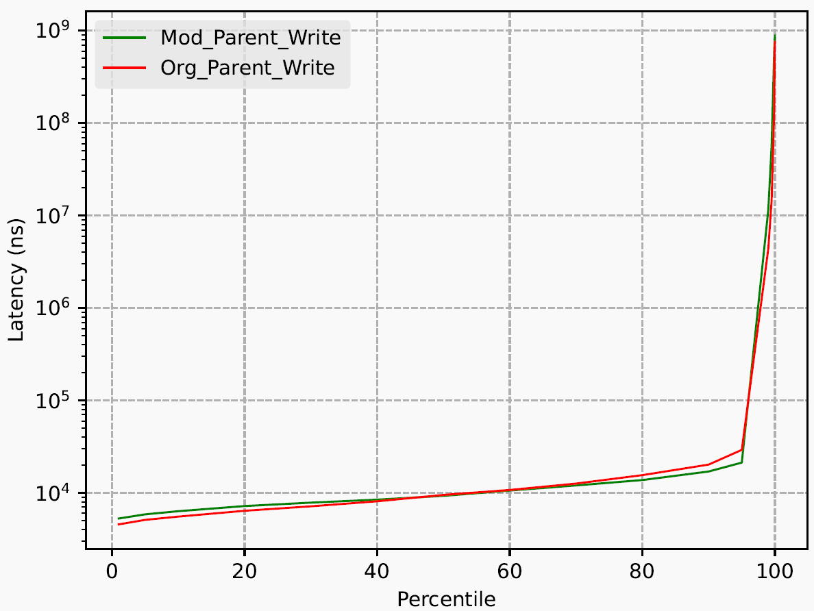
Comparison of latencies, with both parent and child writing

Slide 62
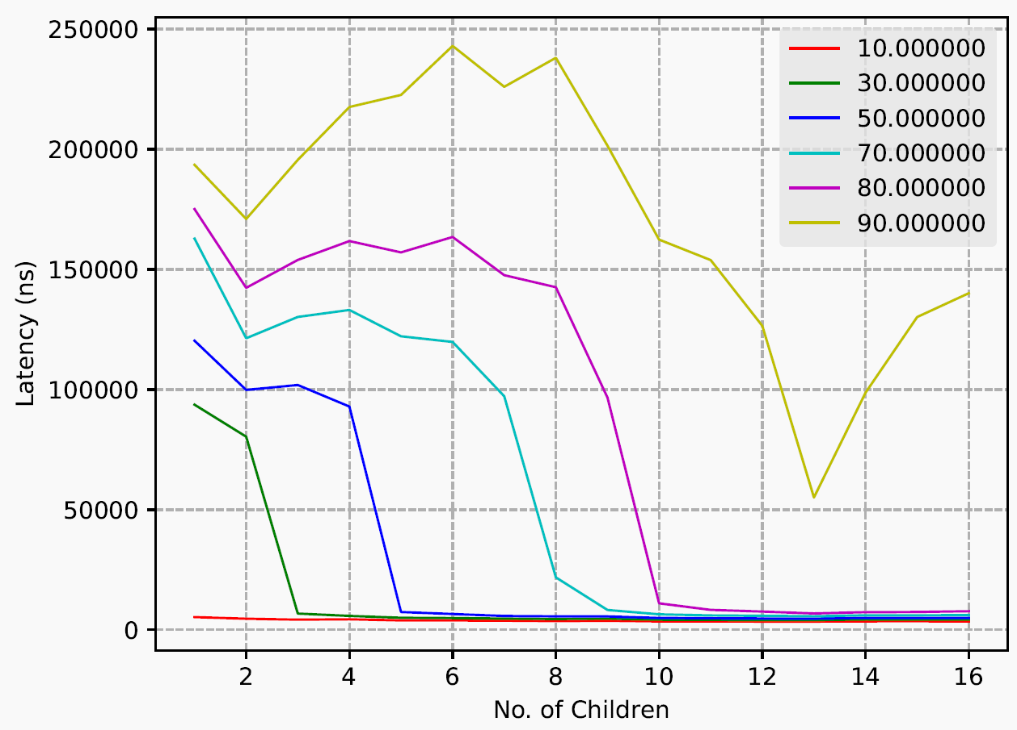
Average Read Latency with multiple children reading and writing

Slide 63
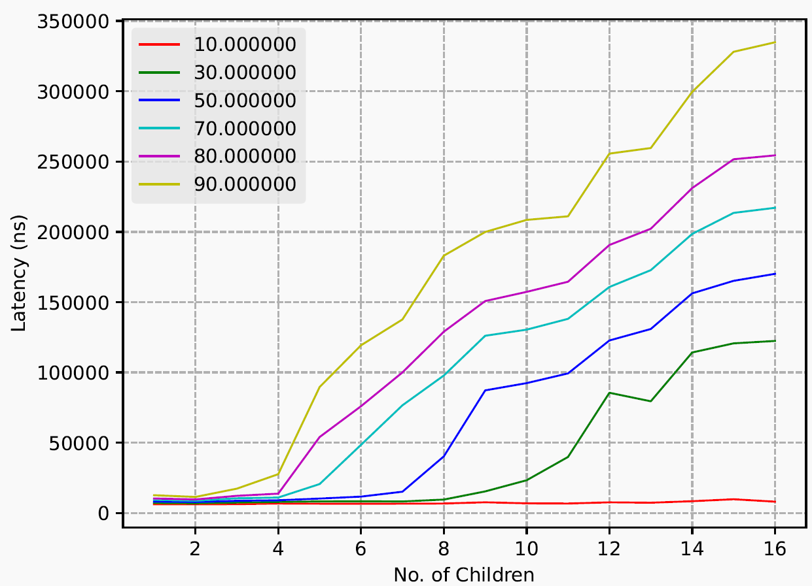
Average Write Latency with multiple children reading and writing

Slide 64
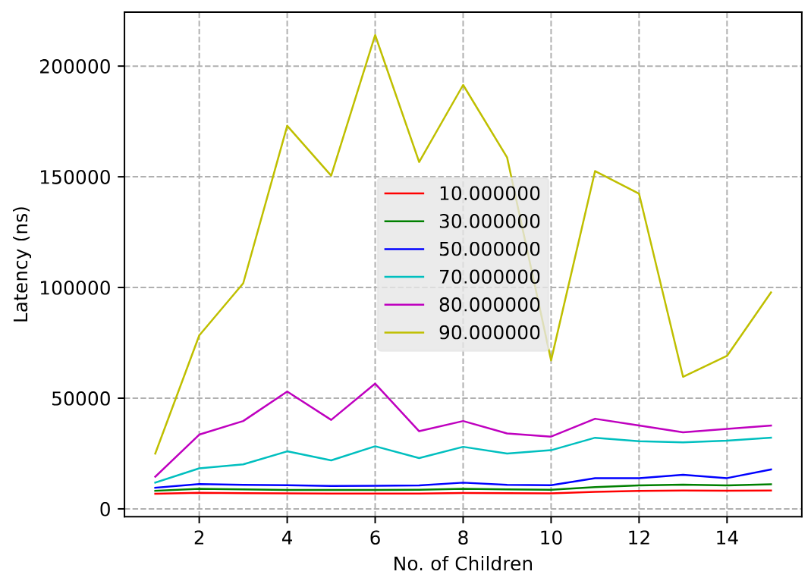
Average Parent Write Latency with Multiple Children Reading

Slide 65
Thank You
Gitlab Repo: https://git.cse.iitk.ac.in/parinayc/btrfs-page-cache-sharing

